Slide 1
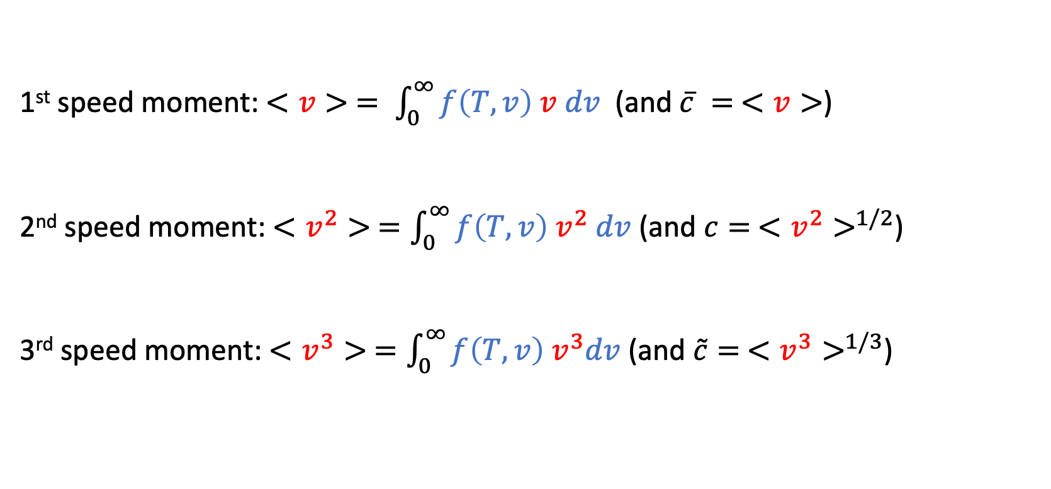
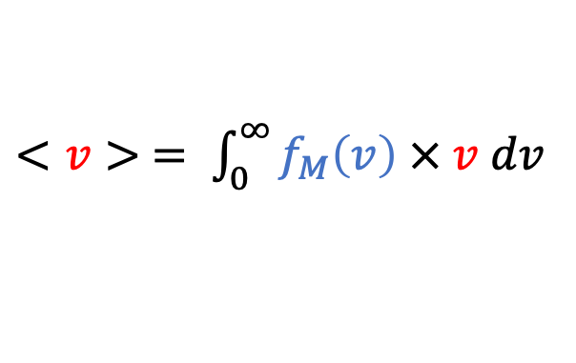
Recap: probability-weighted averaging yields “speed moments”
$<v> = \int_{0}^{∞}{f_{M}\left(v\right) × v dv}$
probability density
speed
1st speed moment: $<v> = \int_{0}^{∞}{f\left(T,v\right) v dv}$ (and $\overline{c} = <v>$)
2nd speed moment: $<v^{2}> =\int_{0}^{∞}{f\left(T,v\right) v^{2} dv}$ (and $c= <v^{2}>^{1/2}$)
3rd speed moment: $<v^{3}> =\int_{0}^{∞}{f\left(T,v\right){ v}^{3}dv}$ (and $\tilde{c}= <v^{3}>^{1/3}$)

Slide 2
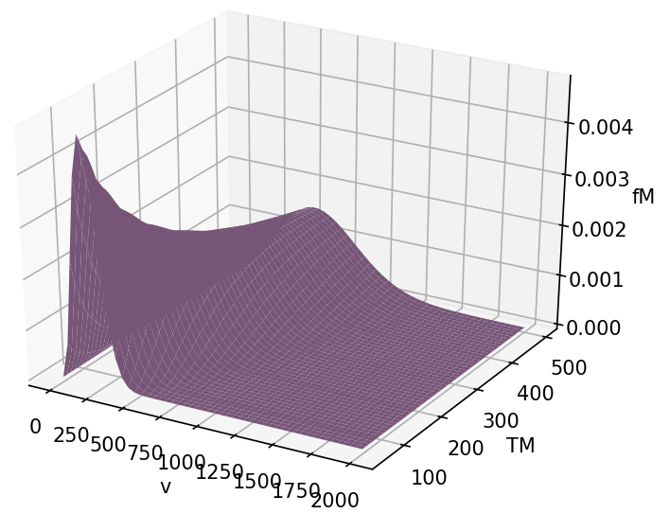
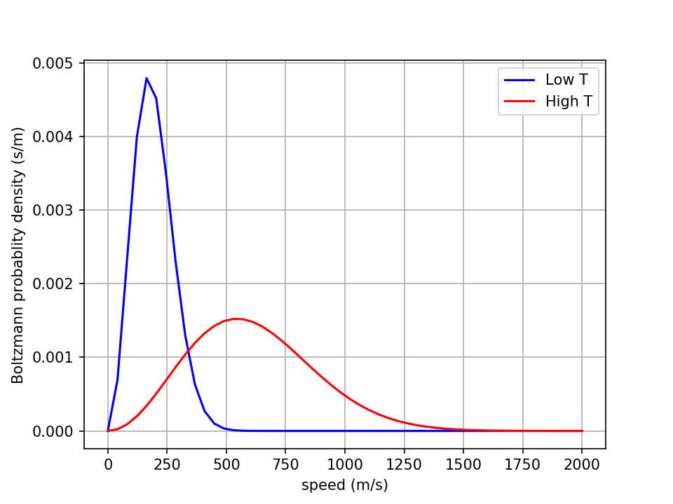
How to get those speed moments? A numerical approach is pretty easy: First we slice …

Slide 3
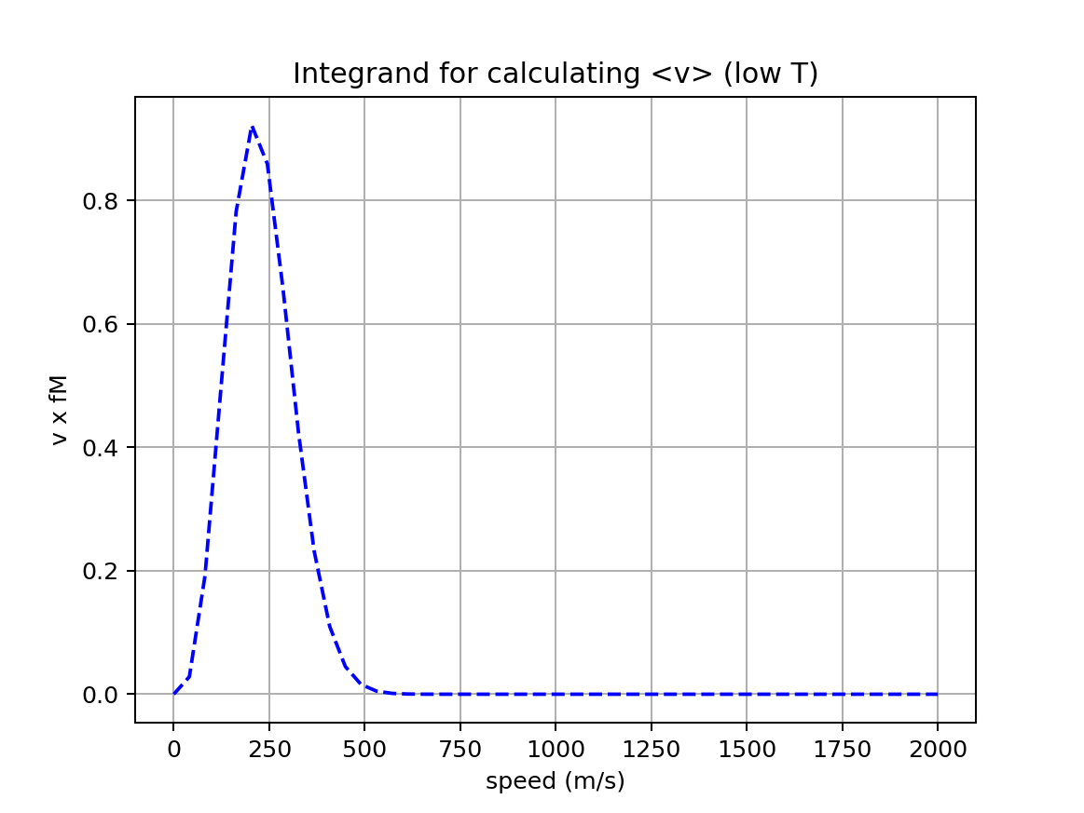
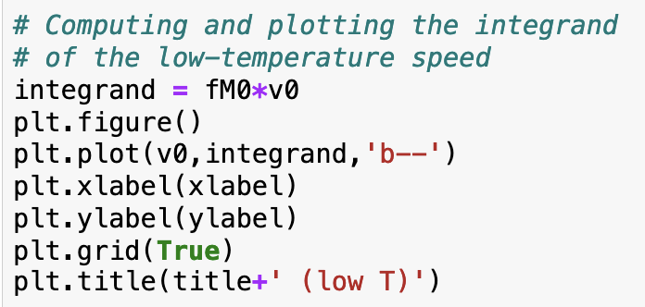
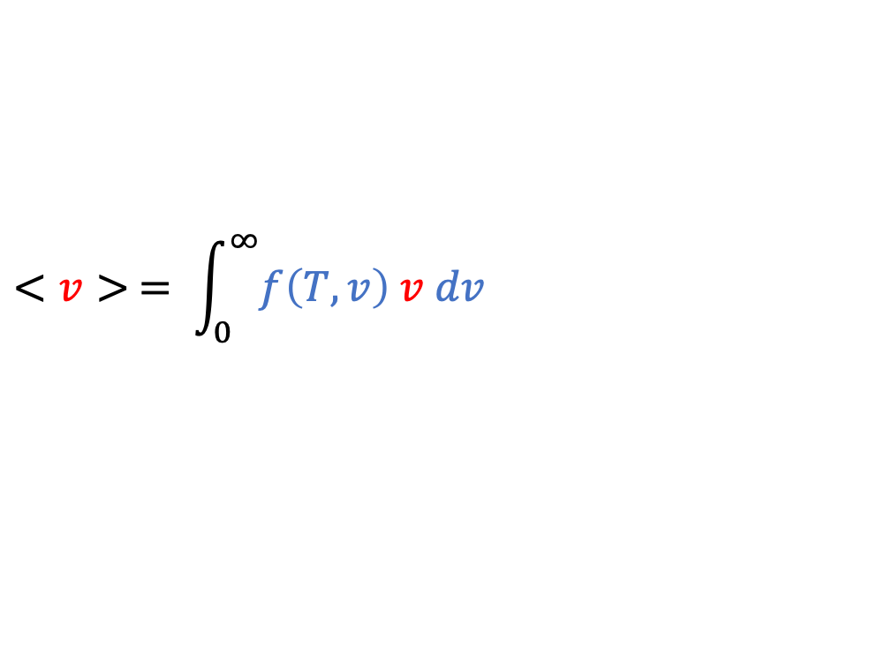
… then we compute and plot the integrand
$$<v> = \int_{0}^{∞}{f\left(T,v\right) v dv}$$

Slide 4
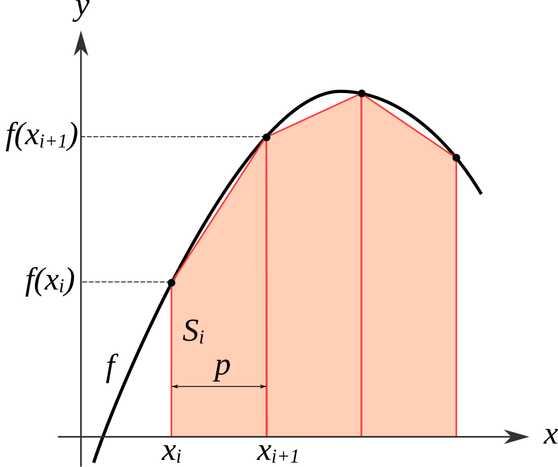

Then we use Python’s trapezoidal rule integrator!
https://en.wikipedia.org/wiki/Trapezoidal_rule
integrand
integral
Generally, the syntax is: Integral = np.trapz(integrand, x)
In our case
“x” will be $v$ (speed) or $v_{x}$ (a velocity component)
The integrand will be $f_{M}\left(T,v\right)$or $f_{B}\left(T,v_{x}\right)$

Slide 5
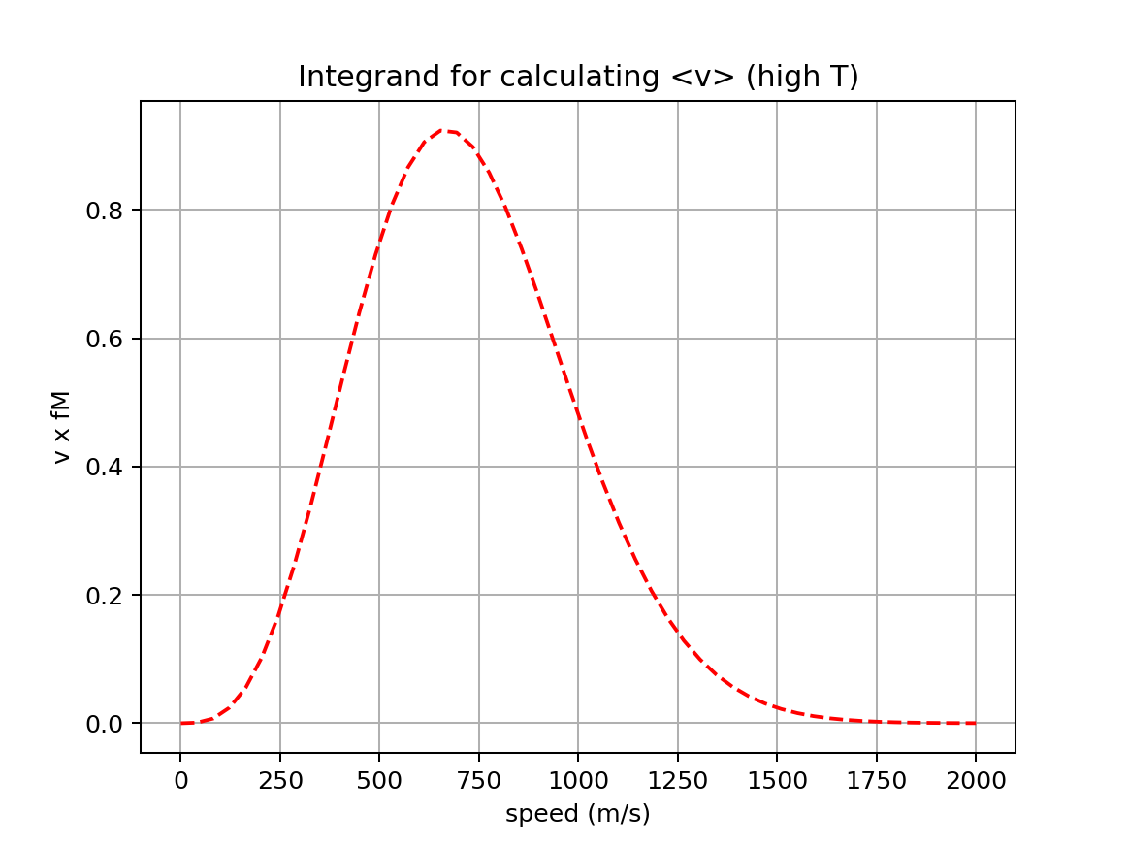
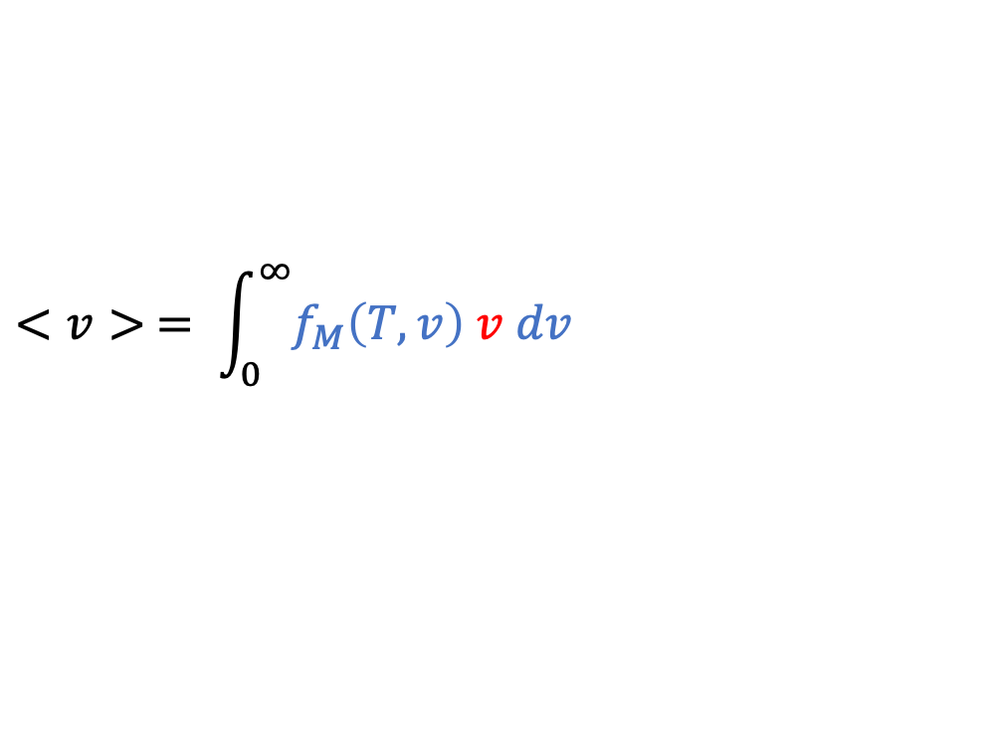
Why graph the integrand? To make sure it goes to zero in the high-speed limit
$$<v> = \int_{0}^{∞}{f_{M}\left(T,v\right) v dv}$$

Slide 6
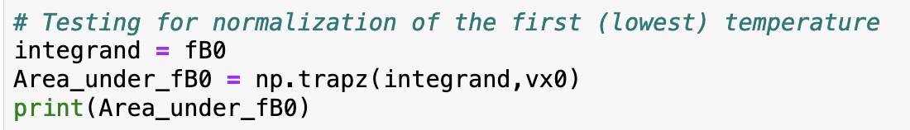
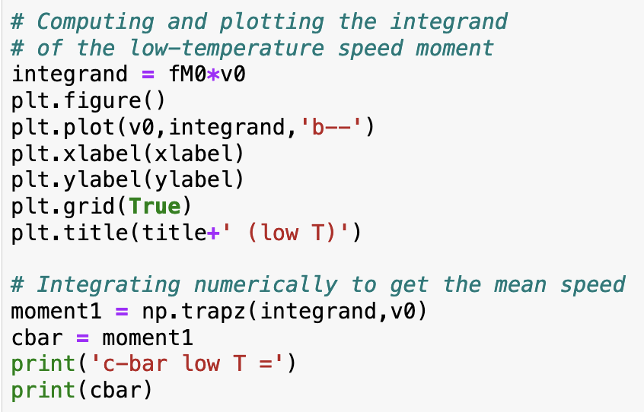
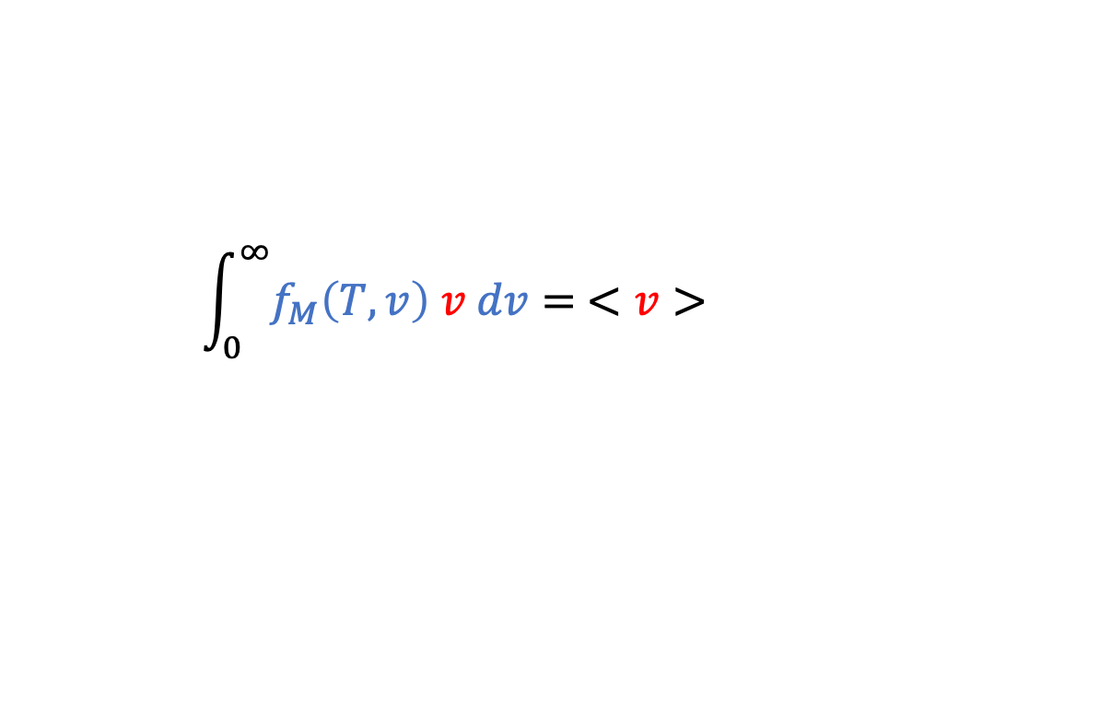
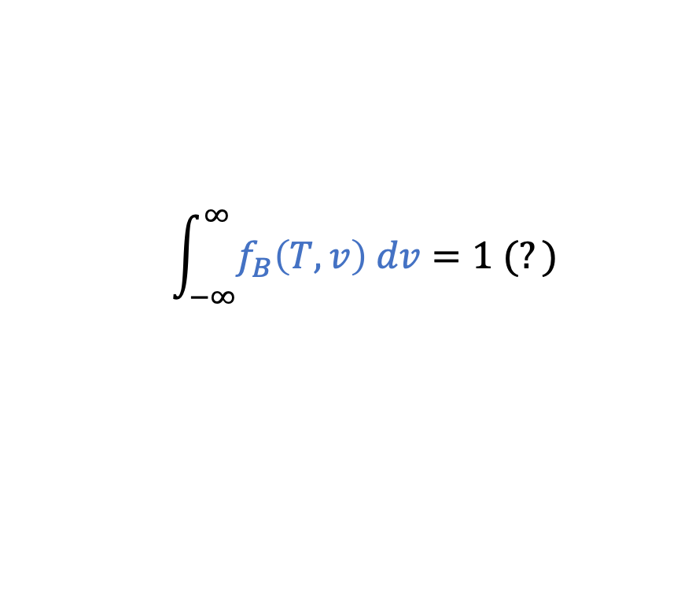
We can integrate all kinds of things numerically using the trapezoidal rule
$$\int_{−∞}^{∞}{f_{B}\left(T,v\right) dv}=1 (?)$$
$$\int_{0}^{∞}{f_{M}\left(T,v\right) v dv}= <v>$$

Slide 7
Remaining work today
Solve the integrals $<v>$ , $<v^{2}>$ , and $<v^{3}>$ analytically (integral tables)
Compare these analytical results to numerical one we got before (Python)

Slide 8
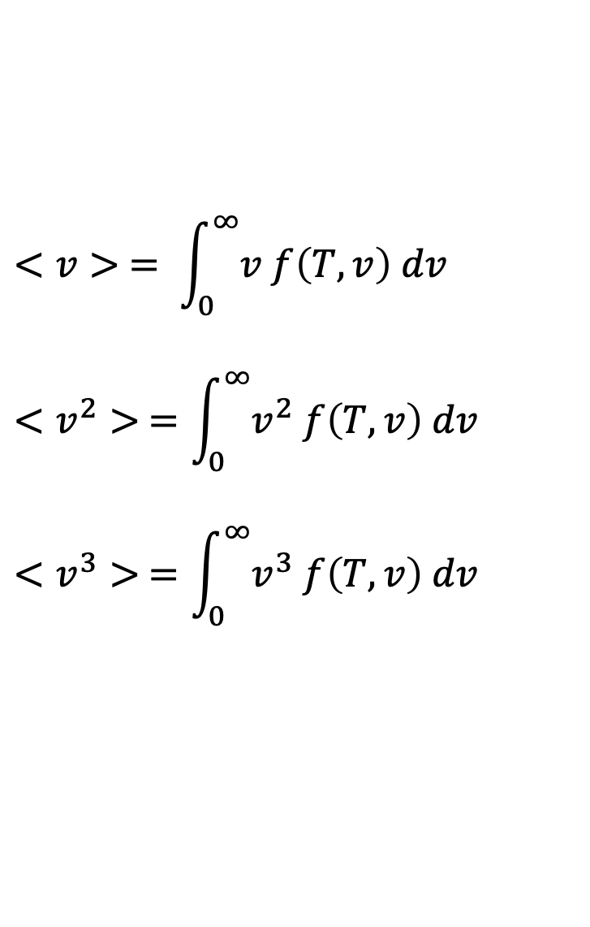
Integral tables
$$<v> = \int_{0}^{∞}{v f\left(T,v\right) dv}$$
$$<v^{2}> =\int_{0}^{∞}{v^{2} f\left(T,v\right) dv}$$
$$<v^{3}> =\int_{0}^{∞}{v^{3} f\left(T,v\right) dv}$$

Slide 9
Integral tables
$$<v> = \int_{0}^{∞}{v f\left(T,v\right) dv}$$
$$<v^{2}> =\int_{0}^{∞}{v^{2} f\left(T,v\right) dv}$$
$$<v^{3}> =\int_{0}^{∞}{v^{3} f\left(T,v\right) dv}$$

Slide 10
